Slide 1
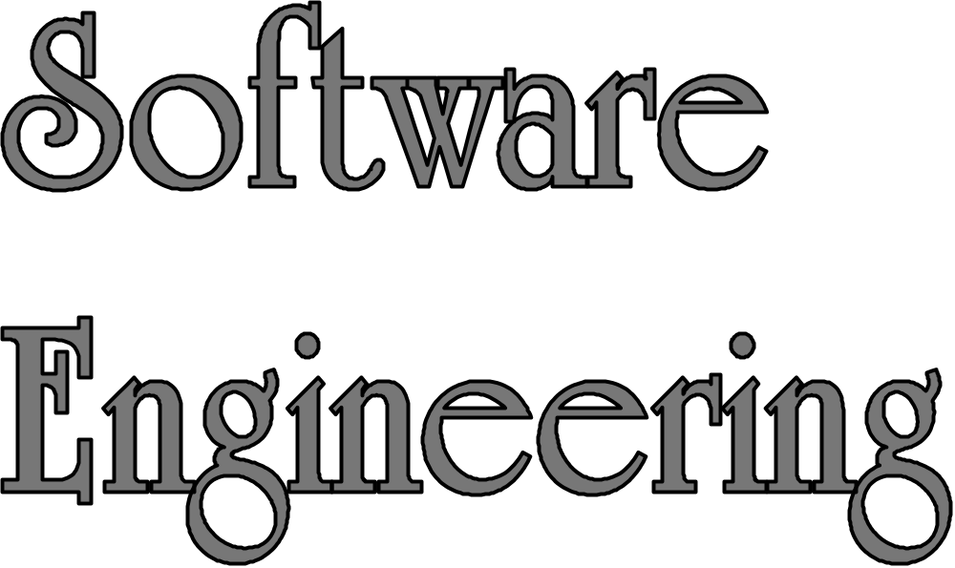
Spring 2020
LECTURE 01: Introduction

Slide 2
Goals of the course
You will learn about
  SE intro and basics
  Software process models i.e. Traditional (Spiral, CBSE) and Non-Traditional (Scrum, Kanban)
  Software process improvement models (CMMI etc)
  RE, Architecture Design, Testing
  Project Management
Dr. Arshad A. Shahid, and .......
DCS-NUCES Islamabad
Notes:
Component-based software engineering (CBSE) is an approach to software development emerged in the 1990's that relies on the reuse of entities called 'software components.
The Capability Maturity Model Integration (CMMI) is a process and behavioral model that helps organizations streamline process improvement and encourage productive, efficient behaviors that decrease risks in software, product and service development

Slide 3
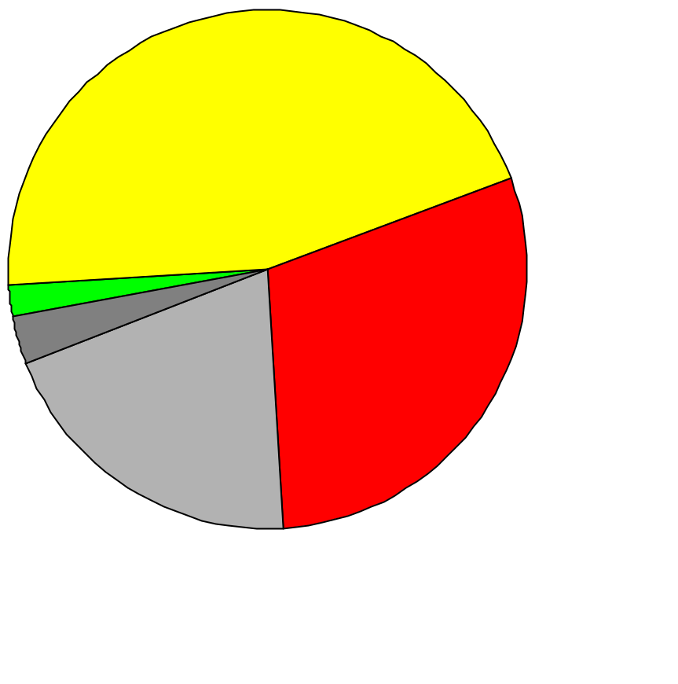
Why Software Engineering?
9 software projects totaling $96.7 million: Where The Money Went
[Report to Congress, Comptroller General, 1979]
Delivered, but never
successfully used
45%
Used as delivered 2%
Paid for, but not delivered 30%
Usable w. rework 3%
Used w. extensive rework, but later abandoned 20%
Take a look at the Standish Report (The “Chaos” Report)
Dr. Arshad A. Shahid, and .......
DCS-NUCES Islamabad
Notes:
The Chaos Report by Standish Group

Slide 4
Software Production has a Poor Track Record
Example: Space Shuttle Software
Cost: $10 Billion, millions of dollars more than planned
Time: 3 years late
Quality: First launch of Columbia was cancelled because of a synchronization problem with the Shuttle's 5 onboard computers.
  Error was traced back to a change made 2 years earlier when a programmer changed a delay factor in an interrupt handler from 50 to 80 milliseconds.
  The likelihood of the error was small enough, that the error caused no harm during thousands of hours of testing.
Substantial errors still exist.
  Astronauts are supplied with a book of known software problems "Program Notes and Waivers".
Take a look at the Standish Report (The “Chaos” Report)
Dr. Arshad A. Shahid, and .......
DCS-NUCES Islamabad
Notes:
The Chaos Report by Standish Group

Slide 5
What is software?
Computer programs and associated documentation
Software products may be developed for a particular customer or may be developed for a general market
Software products may be:
  Generic - developed to be sold to a range of different customers (developed as a product)
  Bespoke (custom) - developed for a single customer according to their specification (developed as a project)
Dr. Arshad A. Shahid, and .......
DCS-NUCES Islamabad
Notes:
Any difference between 2 & 3 ???
++

Slide 6
What is software engineering?
Software engineering is an engineering discipline which is concerned with all aspects of software production.
Software engineers should adopt a systematic and organised approach to their work and use appropriate tools and techniques depending on the problem to be solved, the development constraints and the resources available.
Dr. Arshad A. Shahid, and .......
DCS-NUCES Islamabad

Slide 7
Difference between software engineering and computer science?
Computer science is concerned with theory and fundamentals; software engineering is concerned with the practicalities of developing and delivering useful software
Computer science theories are currently insufficient to act as a complete underpinning for software engineering
Dr. Arshad A. Shahid, and .......
DCS-NUCES Islamabad
Notes:
Underpinning >> foundation, supporting
Irrelevant text: [To answer, we need to bring the day names and the day numbers into coordination……] ???

Slide 8
Introduction: Software is Complex
Complex ≠ complicated
Complex = composed of many simple parts
related to one another
Complicated = not well understood, or explained
Irreducible essence of modern software: Complexity, Conformity, Changeability, and Invisibility [F.P. Brooks, No Silver bullet]
Dr. Arshad A. Shahid, and .......
DCS-NUCES Islamabad
Notes:
++ Software Essence: F.P Broks:

Slide 9


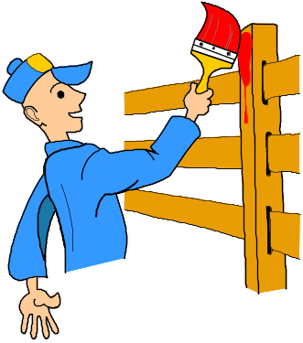

Complexity Example:
Scheduling Fence Construction Tasks
Setting posts
[ 3 time units ]
Cutting wood
[ 2 time units ]
Nailing
[ 2 time units for unpainted;
3 time units otherwise ]
Painting
[ 5 time units for uncut wood;
4 time units otherwise ]
Setting posts < Nailing, Painting
Cutting < Nailing
…shortest possible completion time = ?
 “simple” problem, but hard to solve without a pen and paper ]
Dr. Arshad A. Shahid, and .......
DCS-NUCES Islamabad
Notes:
SOURCE: Goodaire & Parmenter, Discrete Mathematics with Graph Theory, Third Edition, Pearson Prentice Hall, 2006. [ Section 11.5, p. 361 ]
Setting posts < Nailing, Painting ???

Slide 10

More Complexity
Suppose today is Wednesday, Jan 30
What day will be on May 01?
[ To answer, we need to bring the day names and the day numbers into coordination, and for that we may need again a pen and paper ]
Dr. Arshad A. Shahid, and .......
DCS-NUCES Islamabad
Notes:
SOURCE: Hutchins, Cognition in the Wild, The MIT Press, 1995. [ p. 315 ]

Slide 11

The Role of Software Engg. (1)
A bridge from customer needs to programming implementation
Customer
Software Engineering
Programmer
First law of software engineering
Software engineer is willing to learn the problem domain
(problem cannot be solved without understanding it first)
Dr. Arshad A. Shahid, and .......
DCS-NUCES Islamabad
Notes:
"You cannot solve it, unless you understand it.“ [??]

Slide 12
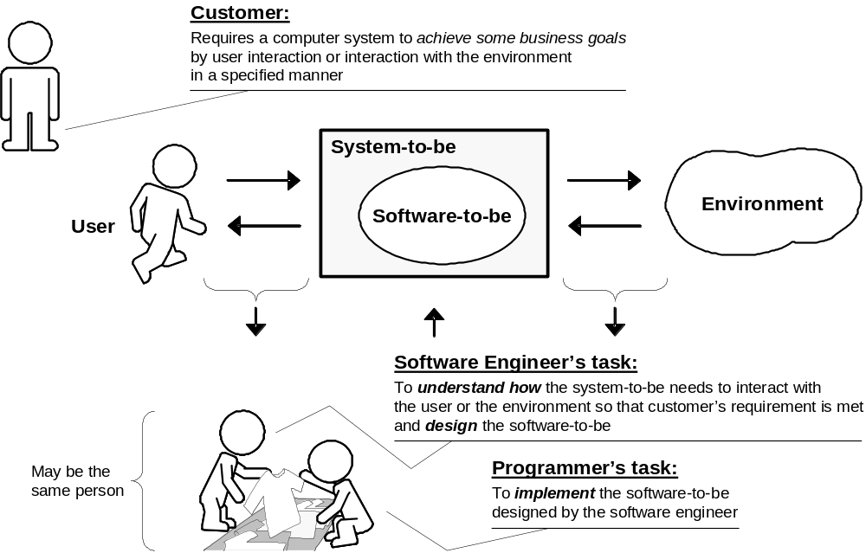
The Role of Software Engg. (2)
Dr. Arshad A. Shahid, and .......
DCS-NUCES Islamabad
Notes:
Source: Ivan Marsic • Rutgers University
Book SE

Slide 13
Second Law of Software Engineering
Software should be written for people first
  (Computers run software, but hardware quickly becomes outdated)
  Useful + good software lives long
  To nurture software, people must be able to understand it.
Dr. Arshad A. Shahid, and .......
DCS-NUCES Islamabad
Notes:
[??]
people first??
Difficult to relate & explain Heading and bullets

Slide 14
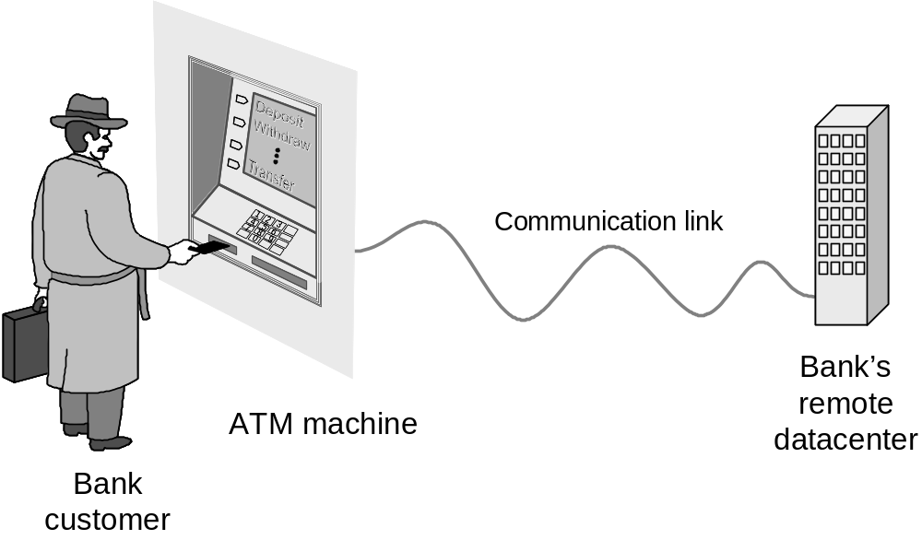
Example: ATM Machine
Understanding the money-machine problem:
Dr. Arshad A. Shahid, and .......
DCS-NUCES Islamabad

Slide 15
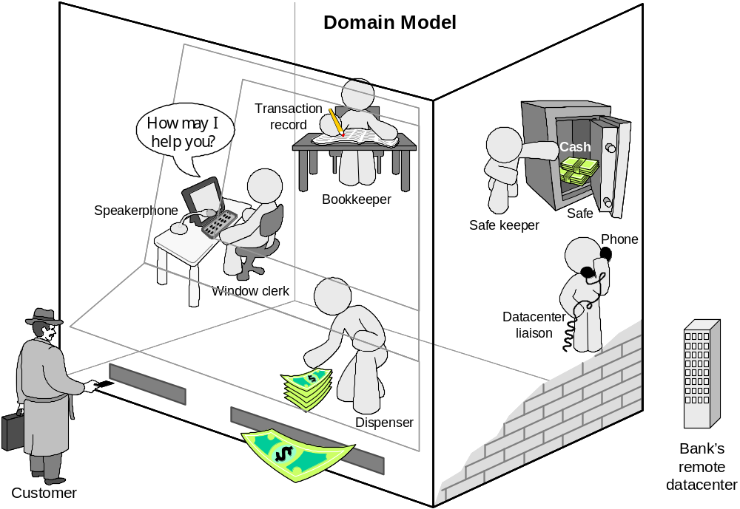
How ATM Machine Might Work`
Domain model created with help of domain expert
Dr. Arshad A. Shahid, and .......
DCS-NUCES Islamabad
Notes:
Objective of this slide?? Understanding Domain??

Slide 16
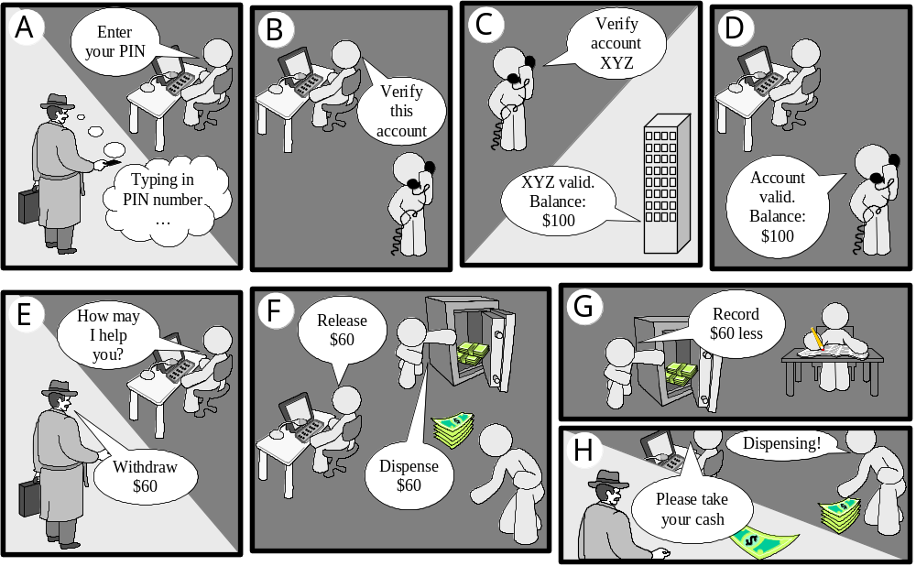
Cartoon Strip: How ATM Machine Works
Dr. Arshad A. Shahid, and .......
DCS-NUCES Islamabad
Notes:
Like a “Withdraw Cash” Usecase

Slide 17
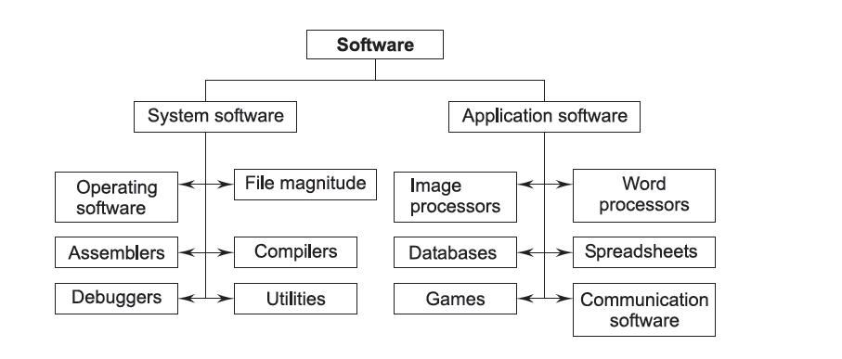

Types of Software
Dr. Arshad A. Shahid, and .......
DCS-NUCES Islamabad
Notes:
Source : Book SE and Testing
B. B. AGARWAL
S. P. TAYAL
M. GUPTA
Is it File Magnitude or Management ???

Slide 18
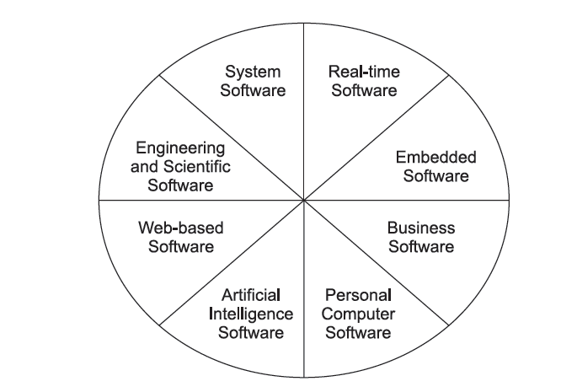
Software Application Types
Dr. Arshad A. Shahid, and .......
DCS-NUCES Islamabad
Notes:
Embedded software" is specialized programming within non-PC devices – either as part of a microchip or as part of another application that sits on top of the chip – to control specific functions of the device.
Source : Book SE and Testing
B. B. AGARWAL
S. P. TAYAL
M. GUPTA
Difference of classification this and prev slide??

Slide 19
Software Application types
Stand-alone applications
  These are application systems that run on a local computer, such as a PC. do not need to be connected to a network.
Interactive transaction-based applications
  Applications that execute on a remote computer and are accessed by users from their own PCs. web applications such as e-commerce applications.
Embedded control systems
  These are software control systems that control and manage hardware devices.
Dr. Arshad A. Shahid, and .......
DCS-NUCES Islamabad
Notes:
Source Ian Sommerville

Slide 20
Application types
Batch processing systems
  These are business systems that are designed to process data in large batches. E.g Credit card companies process bill
Entertainment systems
  Media players etc.
Systems for modeling and simulation
  These are systems that are developed by scientists and engineers to model physical processes or situations, which include many, separate, interacting objects.
Dr. Arshad A. Shahid, and .......
DCS-NUCES Islamabad
Notes:
Source Ian Sommerville

Slide 21
Application types
Data collection systems
  These are systems that collect data from their environment using a set of sensors and send that data to other systems for processing. e.g. RTU in SCADA systems
Systems of systems
  These are systems that are composed of a number of other software systems. e.g. Electric/power grid systems
Dr. Arshad A. Shahid, and .......
DCS-NUCES Islamabad
Notes:
Source Ian Sommerville

Slide 22
Software Development Methods
Method = work strategy
    The Feynman Problem-Solving Algorithm:
    (i) Write down the problem (ii) think very hard, and (iii) write down the answer.
Waterfall
    Unidirectional, finish this step before moving to the next
Iterative + Incremental
    Develop increment of functionality, repeat in a feedback loop
Agile
    User feedback essential; feedback loops on several levels of granularity
Dr. Arshad A. Shahid, and .......
DCS-NUCES Islamabad

Slide 23
What is a software process?
A set of activities whose goal is the development or evolution of software
Generic activities in all software processes are:
  Specification - what the system should do and its development constraints
  Development - production of the software system
  Validation - checking that the software is what the customer wants
  Evolution - changing the software in response to changing demands
Dr. Arshad A. Shahid, and .......
DCS-NUCES Islamabad

Slide 24
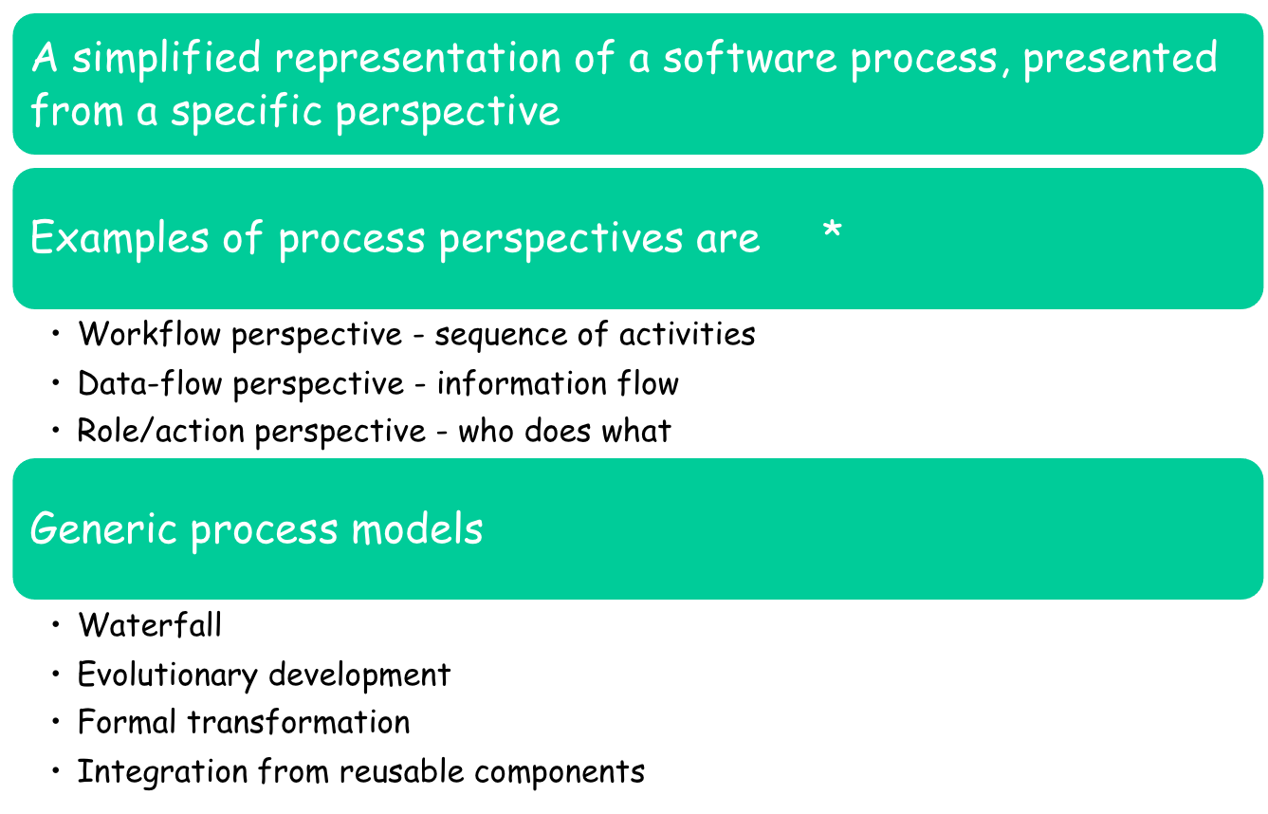
What is a software process model?
Dr. Arshad A. Shahid, and .......
DCS-NUCES Islamabad
Notes:
* Refer to CMM KPA (which specify all such entities)

Slide 25
Software Lifecycle Activities
Deliverable 0
Deliverable 1
Deliverable 2
Deliverable 3
Deliverable 4
Deliverable 5
Deliverable 6
Requirements
Elicitation
Requirements
Analysis
System
Design
Object
Design
Implemen-
tation
Testing
Implemented
By
Expressed in Terms Of
Structured By
Realized By
Verified
By
class...
class...
class...
?
class....
?
Use Case
Model
Application
Domain
Objects
Solution Domain
Objects
SubSystems
Source
Code
Test
Cases
Each activity produces one or more models (artefact)
Dr. Arshad A. Shahid, and .......
DCS-NUCES Islamabad
Notes:
Each activity produces ….. model

Slide 26
What are the attributes of good software?
The software should deliver the required functionality and performance to the user and should be: maintainable, dependable and usable
Maintainability
  Software must evolve to meet changing needs
Dependability
  Software must be trustworthy
Efficiency
  Software should not make wasteful use of system resources
Usability
  Software must be usable by the users for which it was designed
Dr. Arshad A. Shahid, and .......
DCS-NUCES Islamabad
Notes:
Lec 2.5 (2019)
software should deliver………functionality and performance….. > performance is also attribute ?????

Slide 27
Next…
You will study about
  Software process models
Dr. Arshad A. Shahid, and .......
DCS-NUCES Islamabad

